Slide 1

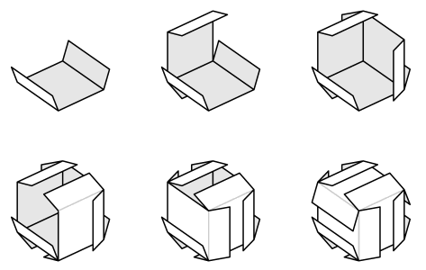
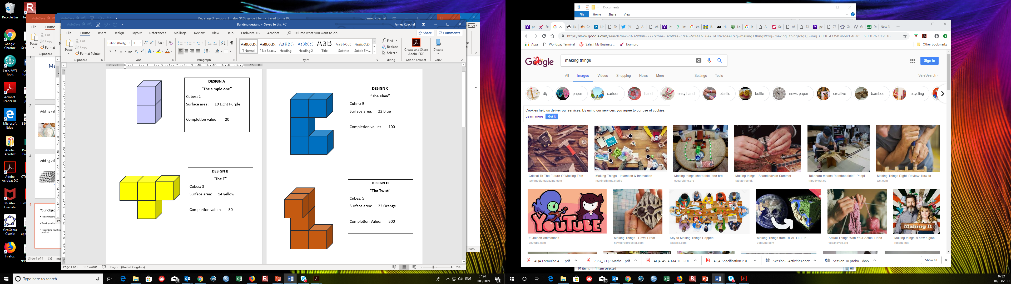
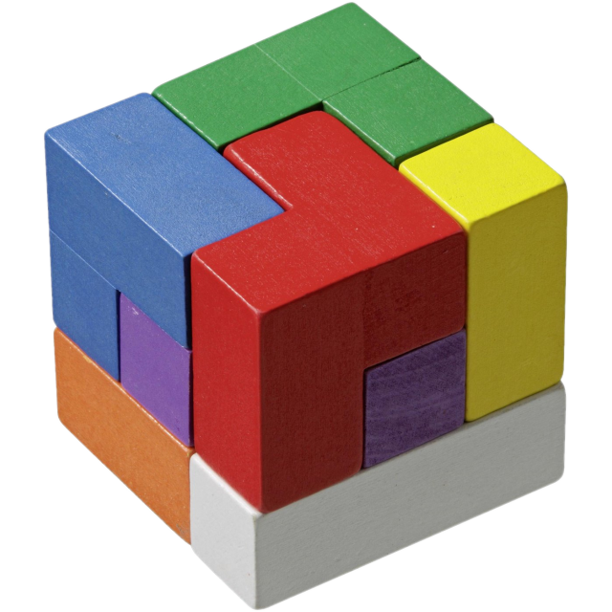
Contract to Cube-it
Notes:
Intro slide.

Slide 2
Who likes Maths?
Can you name any jobs that need you to use maths?
Do you know what manufacturing is?
Notes:
Ask the children if they are looking forward to the session etc……
Get the children to put their hands up and count the number.
These questions will be repeated at the end of the session.

Slide 3
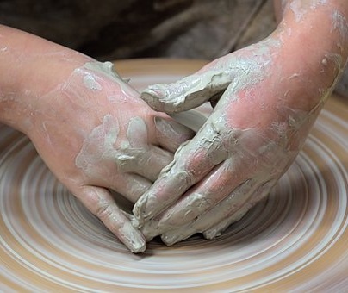

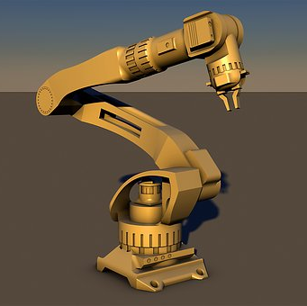
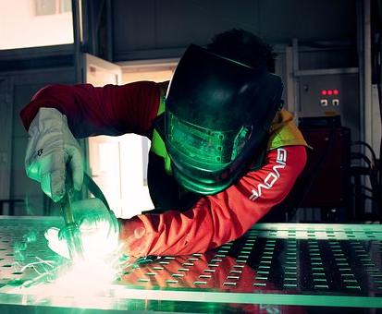
What is manufacturing?
Notes:
This is a great opportunity to discuss with the class what the words manufacturing and business mean.
I also gave a personal introduction as to myself coming from a “business cluster” that is a group of businesses hoping to collaborate and help each other out as well as the local community.

Slide 4
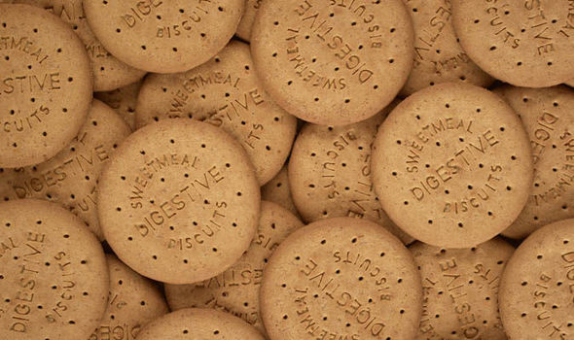
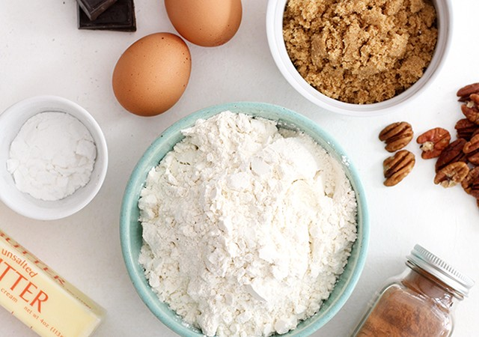
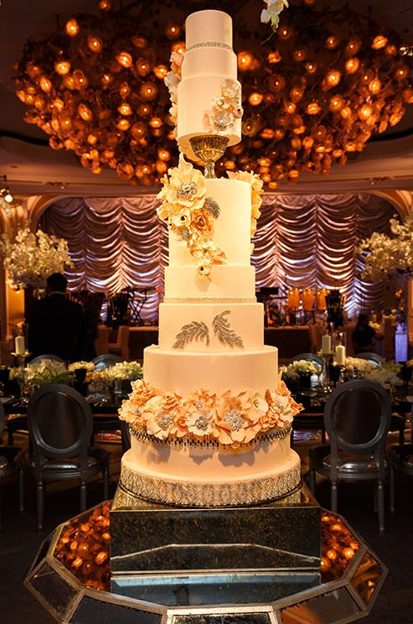
Adding value
Notes:
Here we discuss adding value. The example is taking cheap ingredients and turning them into something you can sell for a bigger price.
Activity: how much does biscuits sell for? How much does wedding cake sell for.
Vote: would you rather make lots and lots of biscuits or one big cake? What are the advantages and disadvantages of either?

Slide 5
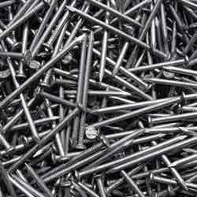
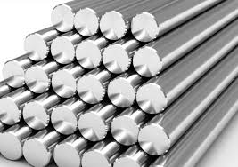
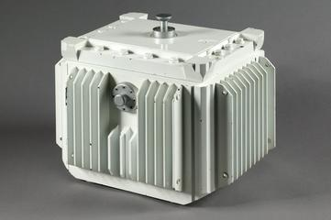
Adding value
Notes:
More boring example, but same concept.
How much does a nail cost? And how many would you have to sell to make money?
What is the item on the bottom? (Nuclear flask)
Guess its value - +£10million, but takes a year to build.

Slide 6
Your objective
Buy materials to make cubes
Turn you cubes into components
To sell your components for money
To combine your finished components
to make a high value product
Notes:
Overall session objectives:
Make simple cubes, turn into designs in the booklet.
Explain the use of their ”Sell” cards to make money. Use “Buy” cards to get better colours for more expensive designs.
Overall objective is to make as much money as possible.
Final structure will pay lots if you make a solid 3X3 (or bigger) cube.

Slide 7
But First!
Your team will need an imaginative company name….
Notes:
An optional activity but usually gets the learners excited,

Slide 8
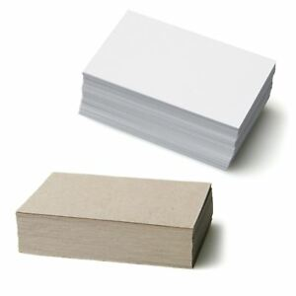
How to build a cube:
Building your first cube without any glue or tape is difficult, you need to watch the demonstration carefully.
Notes:
CAREFUL DEMO REQUIRED
Of building, connecting and colouring.
Master builder stickers are useful in praising successful completions.
Glue on stand by, but from experience this isn’t usually needed.
Usually a couple on each team can build really well, but the teams will naturally involve into productions lines with some folding, connecting or colouring.

Slide 9
Your objective
Buy materials to make cubes
Turn you cubes into components
To sell your components for money
To combine your finished components
to make a high value product
Notes:
Reminder for learners of objectives.
Make simple cubes, turn into designs in the booklet.
Use ”Sell” cards to make money. Use “Buy” cards to get better colours for more expensive designs.
Overall objective is to make as much money as possible.
Final structure will pay lots if you make a solid 3X3 (or bigger) cube.

